Slide 1


3D SCANNER

Slide 2
SUPERVISOR
Software Engineering Defense 2O18
Semester 1, MAIA, M-1
Dr. Yohan Fougerolle
Dr. Cansen Jiang
David Strubel
Group Members
Ama Katseena Yawson MAIA, M-1
Md. Kamrul Hasan MAIA, M-1
Fakrul Islam Tushar MAIA, M-1
Lavsen Dahal MAIA, M-1

Slide 3
Contents of The Presentation
Introduction
Objectives
Microsoft Kinect V2
Speeded Up Robust Features (SURF)
Fast Library for Approximate Nearest Neighbors (FLANN)
Graphical User Interface (GUI)
Results
Future Improvements

Slide 4
Introduction
3D scanning has opened a world of opportunities.
Impact of 3D scanning
Medicine,
Health care,
Research
Education, Visual arts and many more.

Slide 5
Objectives
Improvement in accuracy of previous software developed by our predecessor's.
Development of an improvement software using OpenCV.

Slide 6
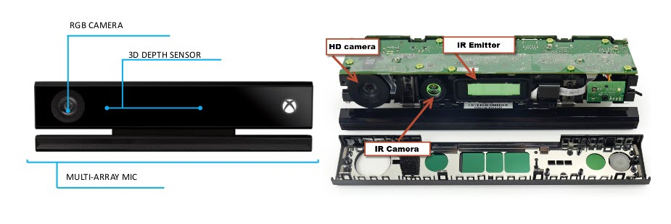
Kinect Sensor

Slide 7
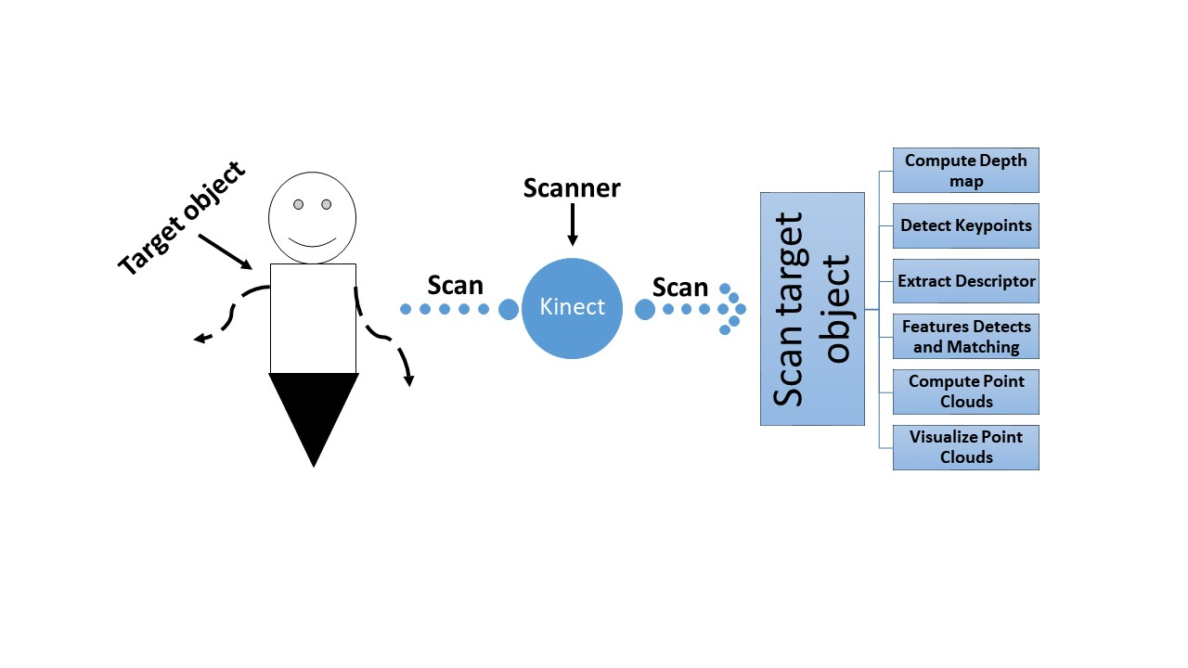
Kinect Procedure Using OpenCV

Slide 8
Algorithms for Feature Matching
Speeded Up Robust Features (SURF)
Fast Library for Approximate Nearest
Neighbors (FLANN)

Slide 9
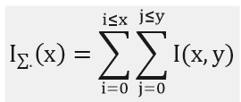




Speeded Up Robust Features (SURF)
SURF is the speeded up version of scale-invariant feature transform (SIFT).

Slide 10
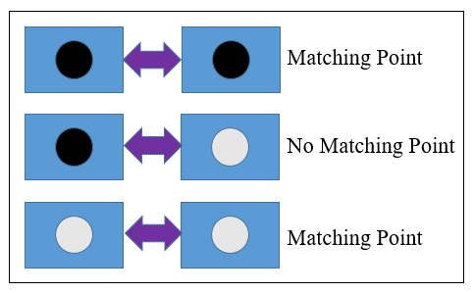

Slide 11
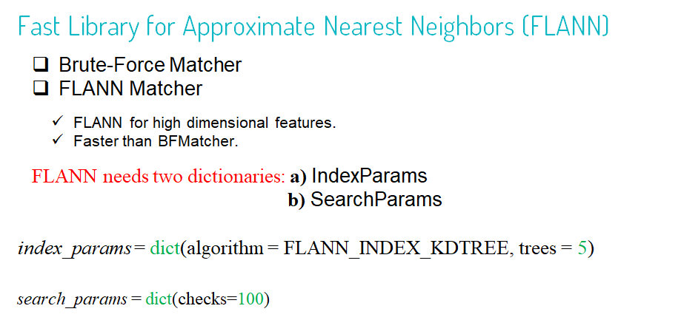

Slide 12
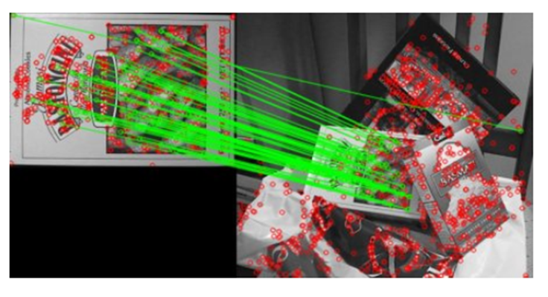

Slide 13
Implementation of Graphical User Interface

Slide 14
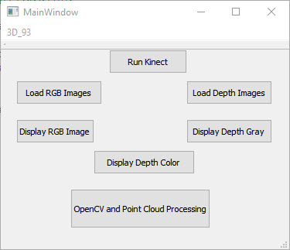
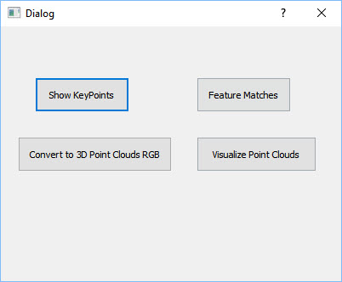
Implementation of Graphical User Interface
(a)
(b)
Fig.3: Preview of the GUI of the project.(a) MainWindown. (b)Dialog Window

Slide 15
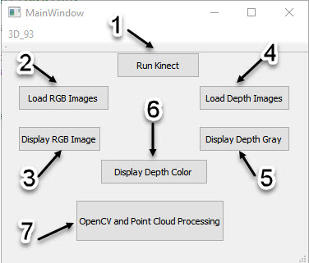
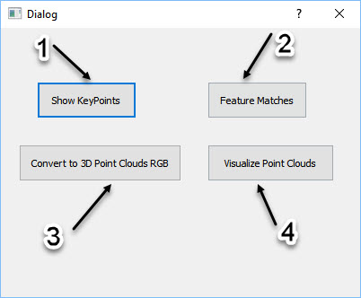
Implementation of Graphical User Interface
(a)
(b)
Fig.4: Shown Different Functionality of the GUI.(a) MainWindown. (b)Dialog Window

Slide 16
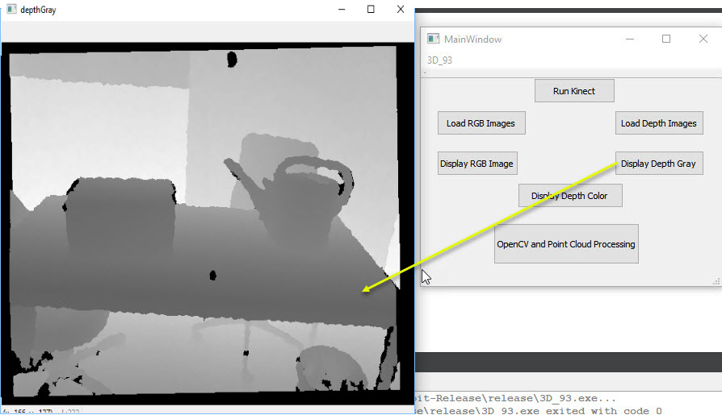
DESIGNED PROTOTYPE
Fig.5: Shown Functionality of Display Depth Image

Slide 17
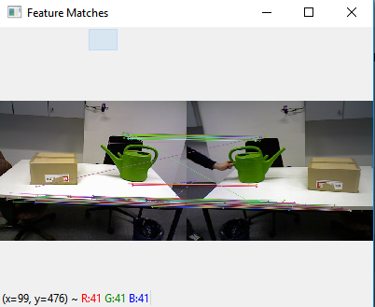
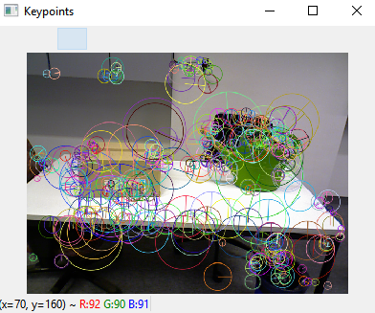
RESULTS

Slide 18
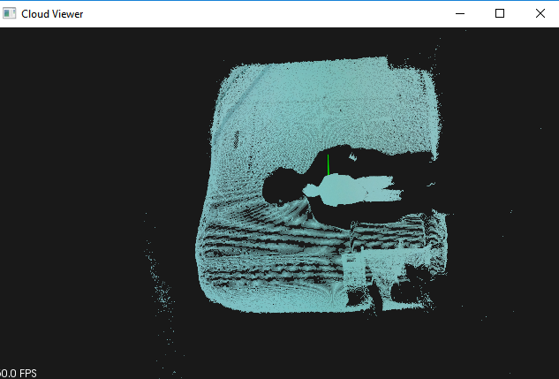
Point Cloud Visualization

Slide 19
Future Improvements
ICP for Registration
Kinect Sensor Integration Improvement
Filtering Methods
Meshing
Improvement in GUI

Slide 20
Thank you !!!☺

